Slide 1

SIWES II DEFENCE Department of computer science and engineering
by
Olaniran, Olarotimi Ademola
CSC/2017/109

Slide 2
Table of Content
1. Introduction
2. Workdone
i. Software Engineering with Reactjs, Nextjs & Typescript
ii. Networking Basics
iii. Hardware Development
3 Conclusion

Slide 3

Introduction
The Students Industrial Work Experience Scheme (SIWES) is an expertise securing preparing program intended to uncover and get ready understudies of colleges and other tertiary establishments for the Mechanical Work circumstance they are probably going to meet after school
To pave way for undergraduates in the Nigerian institutions to gain modern skills experience and knowledge during their course of study,furnish undergraduates with a chance to apply their hypothetical information in a genuine work circumstance accordingly overcoming any issues among hypothesis and practice.

Slide 4
Introduction(Organisation Brief)
Software studio laboratory is a section of the African Centre for Excellence Software Engineering, Obafemi Awolowo University Ile-Ife. The Centre's primary objective is to establish a widely recognized and respected framework in the region.
The aim of the software studio laboratory is to build national capacities through post graduates training, post doctoral research, short term trainings, conferences and workshop in software engineering, software development applications, networking and development of the internet.

Slide 5
Introduction(Organisation Brief)
It also provides a nurturing space for skill development and knowledge exchange, leading to the creation of software solutions that address a wide range of market needs, both domestically and globally.
Software Studio Laboratory has a tech hub that has a collection of I.T networking experts that collaborate and patiently teach from their knowledge and experience. Also the experts trained at the centre as software developers have been able to produce two major innovations: the “‘Akowe” and the “Kedu” software.

Slide 6

Workdone-Reactjs, Nextjs and Typescript
React.js often referred to as React, is an open-source Javascript library developed by Facebook. It is used for building User interfaces (UIs) for web and mobile applications. React follows a component-based architecture , where UIs are broken down into reusable and self-contained components.

Slide 7
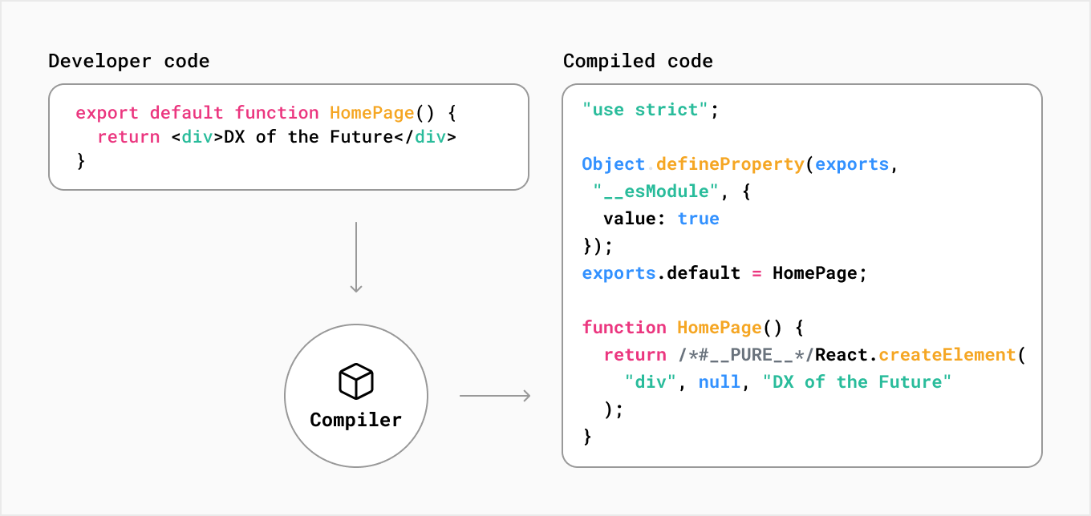
Workdone-Reactjs, Nextjs and Typescript
A compiled Reactjs code

Slide 8
Workdone-Reactjs, Nextjs and Typescript
Developers can create a dynamic and interactive web applications by managing the state and rendering of these components efficiently. React is known for its virtual DOM( Document Object Model), which optimises the updating of the UI for better performance.
Next.js on the other hand, is an open-source React framework developed by vercel. It is used for building server-rendered React applications. Next.js adds features like server-side rendering(SSR) , automatic code splitting, and routing for React applications, making it well suited for projects that require improved performances, SEO optimization and a simplified development experience

Slide 9
Workdone-Reactjs, Nextjs and Typescript
One of the key aspects of my training was gaining a solid understanding of the Reactjs syntax. I learnt about the component-based architecture, JSX syntax, state management, and props. This foundational knowledge allowed me to start building dynamic user interfaces efficiently. As shown in the figure below , the JSX syntax is similar to writing html , css and Javascript on the same page in an efficient and functional manner.

Slide 10
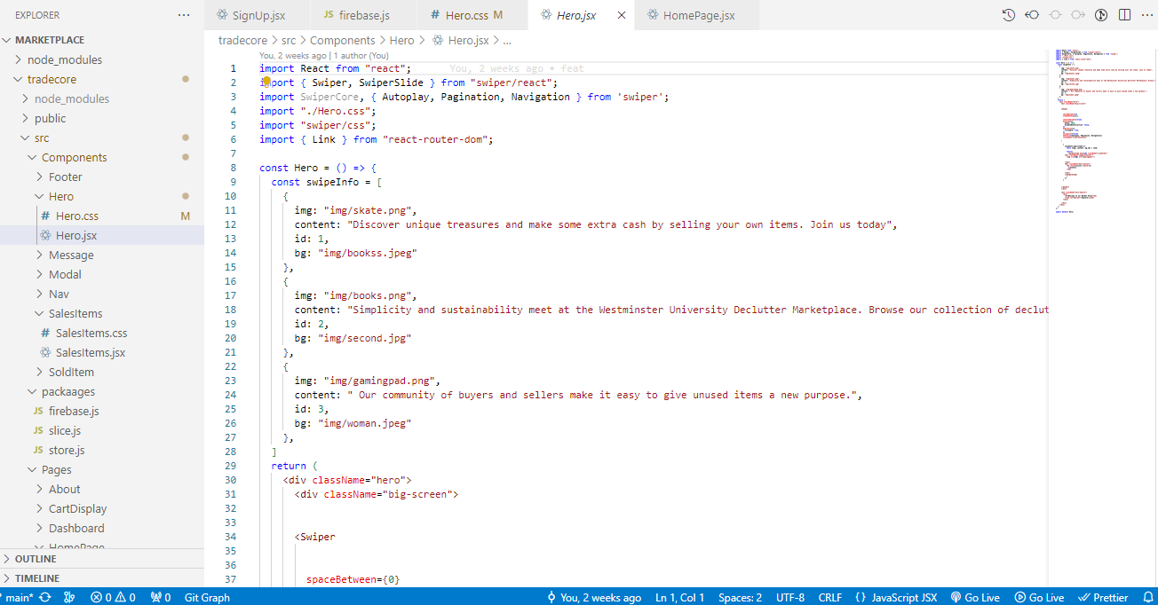
Reactjs Syntax and Folder structure

Slide 11
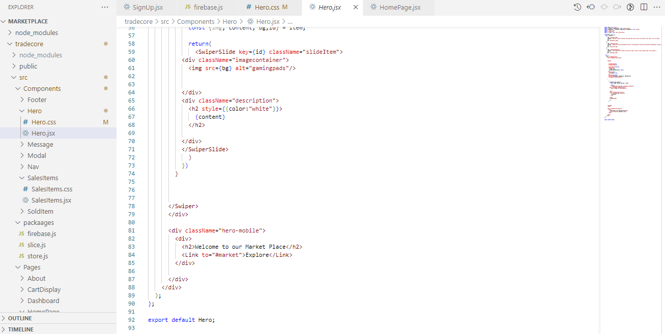
React Js code sample

Slide 12
Workdone-Reactjs, Nextjs and Typescript
React Hooks are a set of functions introduced in React 16.8 that allow functional components to manage state, side effects, and other React features without writing class-based components. They were introduced to simplify and streamline state management and side effect handling in React Project.Some common React Hooks include:
i. useState: Allows functional components to manage local component state. It takes an initial state value and returns the current state and a function to update it.
ii. useEffect: Enables functional components to perform side effects such as data fetching, DOM manipulation, and subscriptions.
iii. useContext: Facilitates the consumption of context in functional components, providing access to shared data and functionality across the component tree.
iv. useRef: is a utility functio that provides a way to create mutable references to DOM elements or values within a functional component.

Slide 13
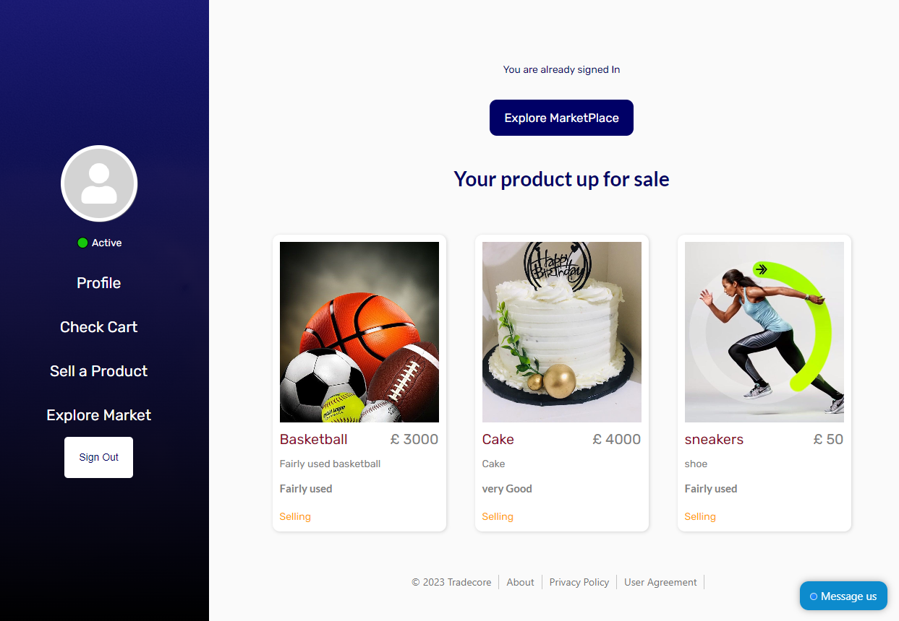
Workdone-Reactjs, Nextjs and Typescript
A typical example of usage of react hooks is controlling dashboard content

Slide 14
Workdone-Reactjs, Nextjs and Typescript
Typescript was integrated into the React.js and Next.js development process. I acquired a strong understanding of Typescript static typing system, enabling me to write safer and more maintainable code by declaring data types. Typescript benefits in terms of code documentation and error prevention were evident in the projects I worked on

Slide 15

Workdone-Reactjs, Nextjs and Typescript
Evogym: This is an online gym access website that allows users and interested visitors to signup and check available facilities. The project is built on Typescript, Next.js and Tailwind css.

Slide 16
Workdone-Reactjs, Nextjs and Typescript
Tradecore: An ecommerce website built with react js and firebase back-end. The platform is to basically serve as an online marketplace for students and lecturers on Obafemi Awolowo University(O.A.U) campus.

Slide 17


Slide 18
Workdone-Reactjs, Nextjs and Typescript

Slide 19
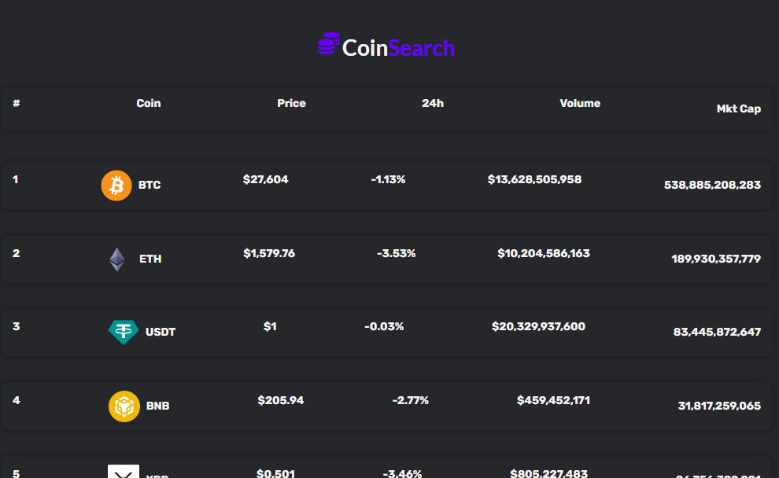
Workdone-Reactjs, Nextjs and Typescript
CoinSearch: Built using Reactjs and CoinGecko API. The platform gets latest price of cryptocurrencies available to users and also provide indepth analysis about existing trades histories, volume and cost.

Slide 20
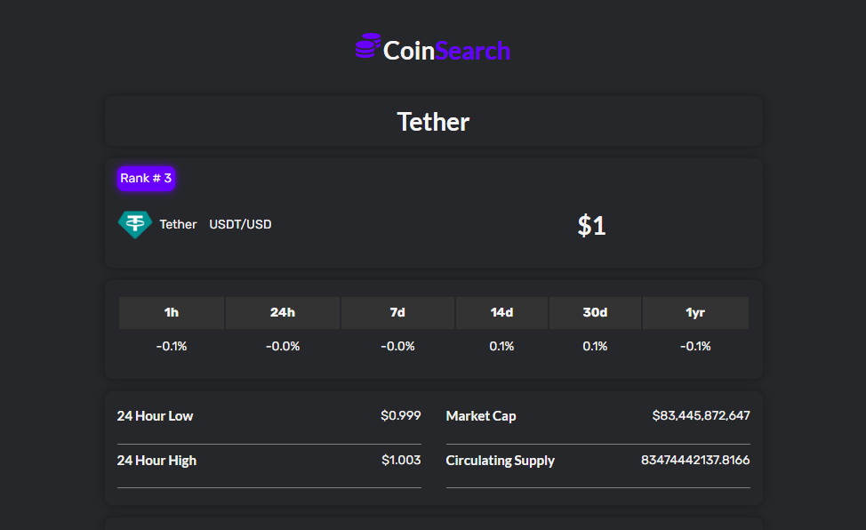
Workdone-Reactjs, Nextjs and Typescript

Slide 21
Workdone-Networking Essentials
During my industrial training period, I had the privilege of participating in an intensive Cisco networking course. This course provided me with a comprehensive understanding of networking technologies and equipped me with valuable skills in configuring, managing, and troubleshooting Cisco networking equipment. The practical experience and knowledge gained during this training have been instrumental in my professional development.
The Cisco networking course began with a solid foundation in the fundamentals of networking. I gained a deep understanding of networking concepts, including OSI model layers, TCP/IP protocols, subnetting, and routing. This knowledge served as the cornerstone for more advanced Cisco-specific topics.
Network security is of paramount importance in today's digital landscape. I received extensive training in Cisco security technologies, including the configuration of firewalls, VPNs (Virtual Private Networks), and intrusion prevention systems (IPS). Understanding Cisco's security solutions was crucial for safeguarding network infrastructure.

Slide 22
Workdone-Networking Essentials
some basic concepts learnt include
Network: A network is a collection of interconnected devices (such as computers, servers, and routers) that can communicate with each other. Networks can be local (LAN), wide-area (WAN), or global (Internet).
Node: A node is a device or computer within a network. Nodes can be endpoints for data transmission, routers that forward data, or switches that manage traffic within a network.
Router: A router is a networking device that connects different networks and forwards data packets between them. It operates at the network layer (Layer 3) of the OSI model.
IP Address: An IP address is a unique numerical label assigned to each device on a network, allowing data to be routed to the correct destination. IPv4 and IPv6 are two common versions of IP addresses.
Firewall: A firewall is a security device or software that controls and filters network traffic to protect a network from unauthorized access and threats.

Slide 23
Workdone-Networking Essentials
LAN (Local Area Network): A LAN is a network that covers a small geographical area, typically within a single building or campus. It is often used for local resource sharing and internal communication.
WAN (Wide Area Network): A WAN is a network that covers a large geographical area, often connecting LANs in different locations. The Internet is a global example of a WAN.
DNS (Domain Name System): DNS is a system that translates human-readable domain names (e.g., www.example.com) into IP addresses, making it easier to locate resources on the Internet.
Client-Server Model: In this model, clients (devices) request services or resources from servers (devices) on a network. It's a common architecture in networking and web services.
Bandwidth: Bandwidth is the maximum data transfer rate of a network or network connection. It is typically measured in bits per second (bps).

Slide 24
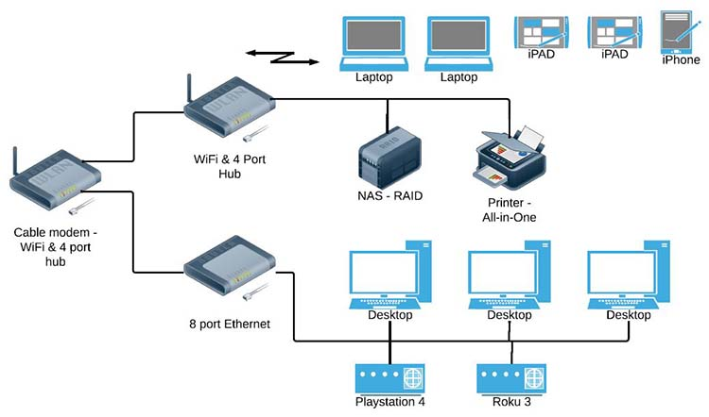
Workdone-Networking Essentials
A significant portion of the training involved hands-on labs and network simulations using Cisco Packet Tracer and other tools. I had the opportunity to configure and troubleshoot network devices, design network topologies, and simulate real-world networking scenarios. These practical exercises reinforced theoretical concepts and enhanced my troubleshooting skills.
Basic home network

Slide 25
Workdone-Hardware Development with Arduino
Arduino is an open-source electronics platform that consists of both hardware and software components. It's designed to make it easy for people, particularly those without extensive electronics or programming experience, to create and experiment with interactive projects. some basic concepts associated with Arduino:
Microcontroller: Arduino boards are equipped with microcontrollers, such as the ATmega series, which execute code and control the behavior of the board. Program code is uploaded to the microcontroller.
Arduino IDE (Integrated Development Environment): The Arduino IDE is a software application used to write, compile, and upload code to the Arduino board. It uses a simplified C/C++ programming language to create programs, which are referred to as "sketches."
Arduino Board: The core of the Arduino platform is the Arduino board, which typically includes a microcontroller (the brain of the board), digital and analog input/output pins, and a USB interface for programming and communication with a computer.

Slide 26
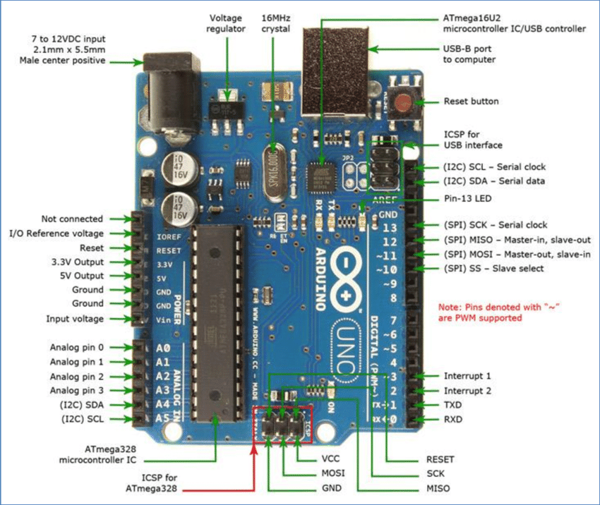
Workdone-Hardware Development with Arduino
Arduino is a user-friendly platform that enables individuals to experiment with electronics and create interactive projects by writing code, connecting sensors and actuators, and using a wide variety of libraries and shields. It's an ideal choice for learning about microcontrollers, embedded systems, and physical computing.

Slide 27
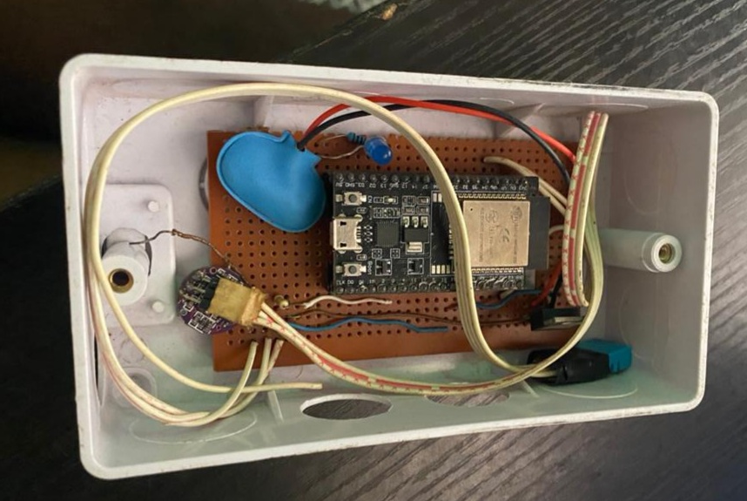
Workdone-Hardware Development with Arduino
I worked on a Health monitoring system with my fellow colleagues doing training at the software studio laboratory. We were able to create a device that measures heart rate and also temperature.

Slide 28

Conclusion
The impact of the program on my personal and professional development has been profound. It has not only enhanced my technical competence but also boosted my confidence in navigating my future career path. I now feel better equipped to face the challenges of the real working world, thanks to the comprehensive training experience and the knowledge I've gained.
During my time at the Software Studio Laboratory at Obafemi Awolowo University, I had the opportunity to delve into various aspects of software development, networking, and hardware development. Specifically, I immersed myself in React JS and Next JS, acquiring practical knowledge that I put into action by creating a project related to these technologies.
As I reflect on my training journey, I can confidently say that the industrial training program successfully accomplished its primary objectives. One of the program's key goals was to prepare students for the demands of the professional world, and it undoubtedly achieved this. By exposing us to real-world scenarios and fostering interactions with professionals, the program has effectively bridged the gap between academic learning and practical application.

Slide 29
Thank You For
Listening

